Slide 1



The Circumgalactic Medium in Dwarf Galaxies
Martin Flores Department of Physics, Arizona State University
Dr. Sanchayeeta Borthakur & Chris Dupuis School of Earth and Space Exploration, Arizona State University
April 18, 2020
Arizona Space Grant Consortium Statewide Symposium

Slide 2
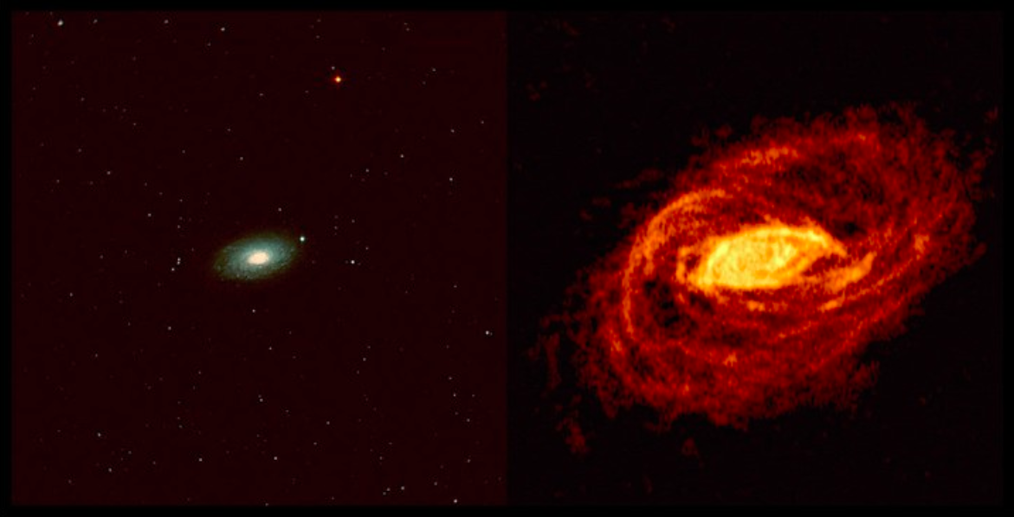
Circumgalactic Medium
NGC 5055 (same scale)
Optical Radio, 21 cm
Generally contains as much mass as stars
Influence on galaxy formation is still not fully understood.
Battaglia et al. 2005
1

Slide 3
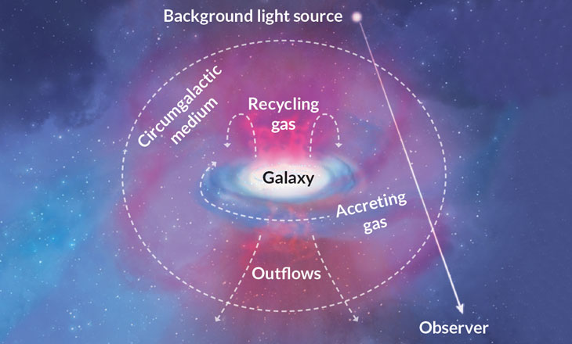
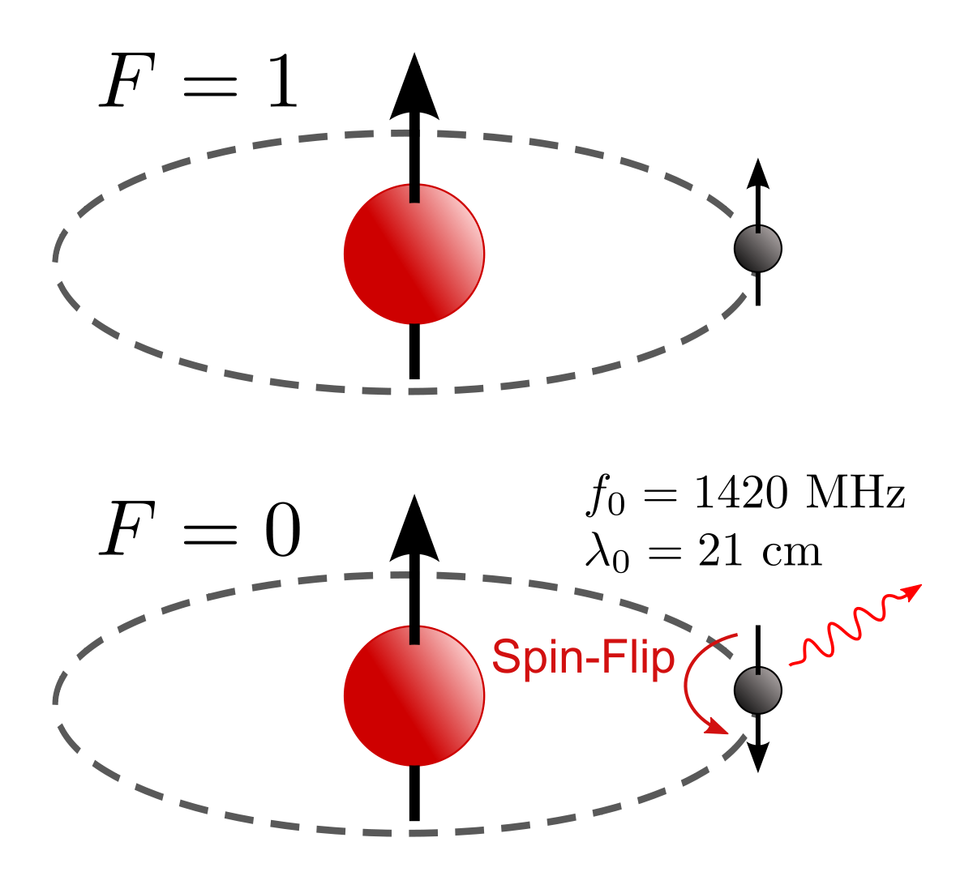
Probing the Gas Reservoirs
Illustration from Tumlinson, Peeples, Werk 2017 ARAA
2

Slide 4
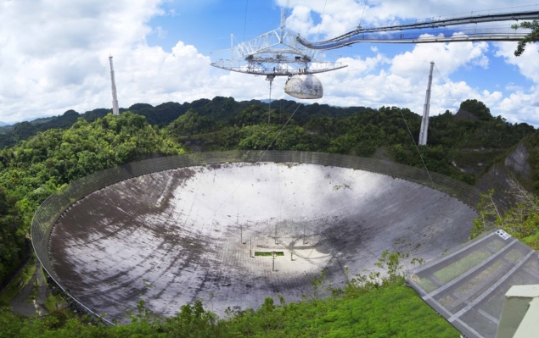
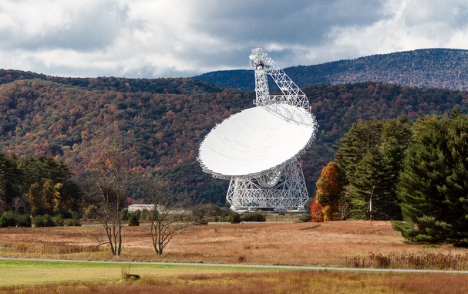
Probing the Gas Reservoirs
Arecibo Telescope
ISM data gathered with the GBT and Arecibo telescope (HI 21cm emission)
Lyα absorption sample obtained from the Hubble Space Telescope program COS-Dwarfs
Green Bank Telescope
by Mark Williamson
by Eric Purcel
3

Slide 5
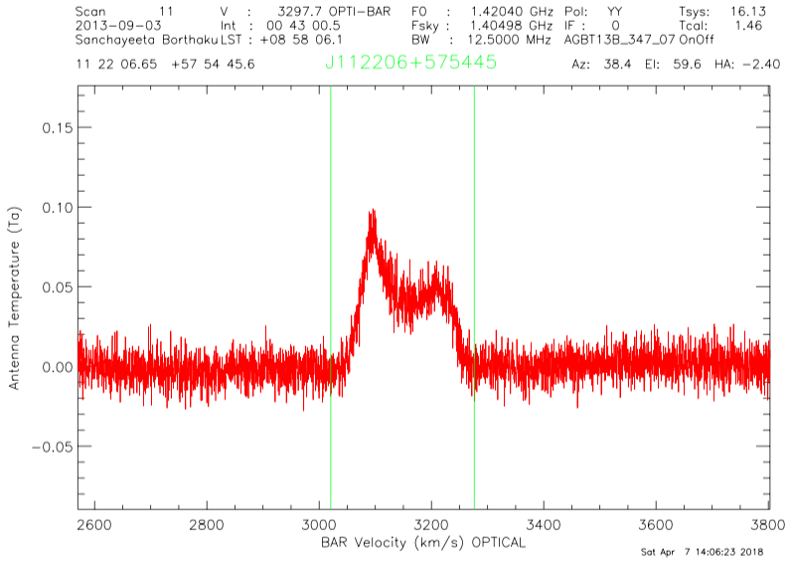
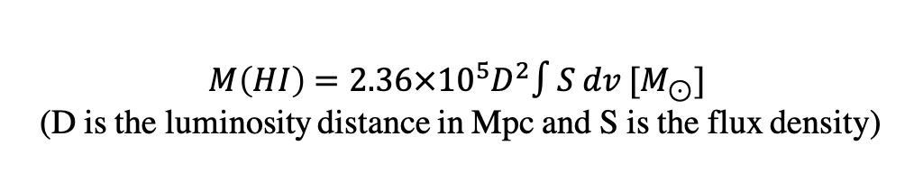
Data Reduction
Reduced using GBTIDL
A limiting equivalent width of five times the noise of the spectra is reported for 5 galaxies classified as non-detections.
Three of the target spectra were corrupted by different absorption systems
$$M\left(HI\right)=2.36×{10}^{5}D^{2}∫S dv [M_{⊙}]$$
(D is the luminosity distance in Mpc and S is the flux density)
4

Slide 6
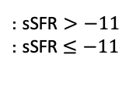
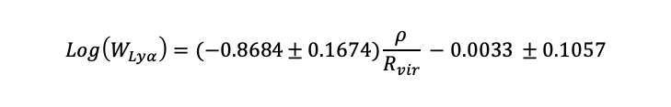
Interpreting Ly⍺ Measurements
$$Log\left(W_{Lyα}\right)=(−0.8684±0.1674)\frac{ρ}{R_{vir}} −0.0033 ±0.1057$$
: sSFR $>−11$
: sSFR$≤−11$
5

Slide 7
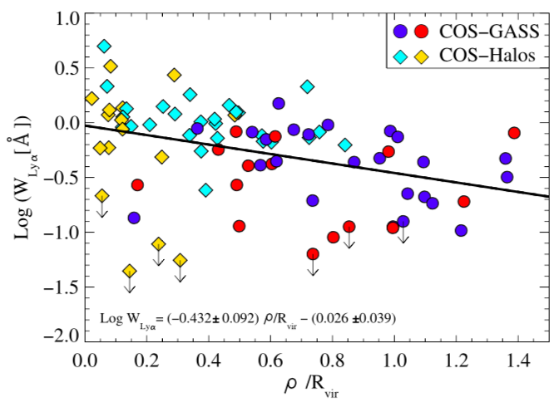
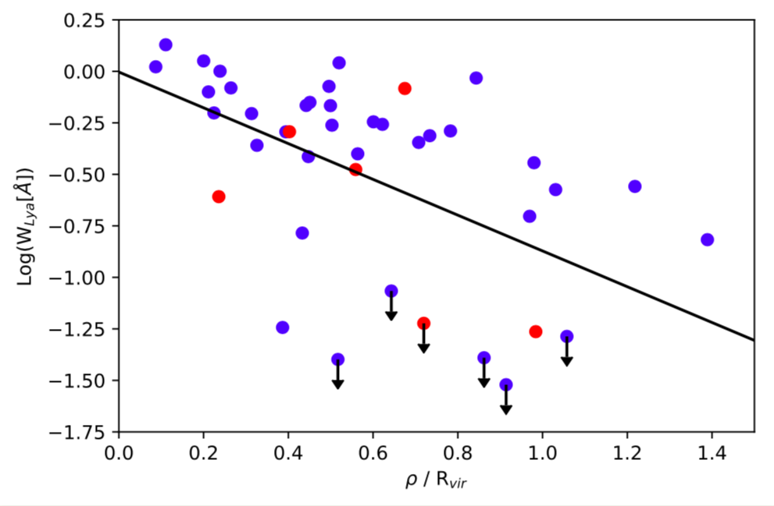
Interpreting Ly⍺ Measurements
Borthakur et al. 2015
6

Slide 8
Connecting the Gas Reservoirs
7

Slide 9
Summary and Future Work
Galaxies show a very good Lyman alpha covering fraction in the inner CGM.
We find gaps in the neutral gas envelope in the outer CGM.
We did not find a correlation between the strength of Lyα in the CGM and HI content in the ISM, indicating that there are gaps in the CGM of dwarf galaxies due to loss of circumgalactic gas via feedback owing to the lower halo masses.
8

Slide 10
Thank you!
Questions?
Martin Flores
maflor36@asu.edu
9

